Slide 2


System redesign to improve linkage and ART initiation rates in Angola – “I-Surge”
Juliana Soares Linn, MD, MPH, MSc
ICAP at Columbia University
“Sticky Linkage”: Latest evidence and strategies satellite
Sunday, July 21

Slide 3
Angola progress towards 95-95-95
Population: estimated 30M (2019)
HIV prevalence gen. pop. 15-49 yrs.: 2.0% (2.6% ♀ - 1.2% ♂)
HIV prevalence FSW: 8.0%
MTCT: 26% (21,000 women get pregnant/year without knowing their HIV status)
ART coverage gen. pop.: 27%
ART coverage pregnant women: 45%
HIGH TB incidence: 359/100,000; TB/HIV: 61/100,000
TB/HIV ART coverage: <10%

Slide 4
I-Surge Transforming Site Support
Hyper-focused strategy to eliminate missed opportunities to test, treat and retain HIV+ patients at supported clinics in Luanda, Angola
Set daily routine of “must do’s” to address known service level gaps.
Focus on Service Optimization All Day/Every Day
  immediate identification and rapid response to performance barriers and missed opportunities
  Real time data collection and use
Implemented in April 2018
PUSH
Community Efforts to Identify, Encourage and Accompany to clinic
PULL
Clinic Efforts to
TEST & START
HOLD ON
Community and Clinic Efforts to Retain in Care

Slide 5


I-Surge Pull and Push
Transforming Site Support Strategy | Transforming Community Support Strategy
Deployment of staff to be based at specific health facilities Focus on facility performance Clinic staff implement PULL strategies, focusing on increased coverage for HIV testing, ART initiation, VL testing and VLS | Focused message on retention, adherence, demand for viral load and viral suppression Focus on outcomes among assigned group of patients Community health workers (CHWs) drive PUSH activities generating demand for HIV services and efforts to track patients who missed visits and to motivate retention and adherence

Slide 6
Technical Approach for I-Surge
1st 90
2nd 90
3rd 90
Health Facility
Patient card completed on arrival
Daily PITC rounds to all wards and out-patient departments
Family testing at every patient encounter
Daily monitoring of HIV testing coverage and index case testing
Community
Community surge team offer daily home-, self-, hot spot, workplace, and weekend testing
Promotion of family, home, self-, and re-testing for those who test HIV-negative
Testing for all pregnant women previously tested negative or status unknown
Structured home visits to all pregnant women, routine family testing, self-testing, and EID
Health facility
Appointment reminder calls
Routine/ same-day Test & Start
Same day FU of missed appointments
Daily monitoring of ART initiations
Community
Home visit to all newly enrolled clients within 7 days
Community, workplace, and hotspot campaigns to discuss benefits of ART and (U=U)
Structured home visits to all pregnant women, with record of each visit that tracks status and treatment
Health facility
Appointment reminders calls
One-on-one adherence counseling at every visit
Patient card/file alert when due for viral load testing
Defaulter card created on same day as missed appointment, with immediate notification of community surge group
Daily monitoring of viral load coverage
Proactive patient education on community resources
Community
If patient defaults, supportive home visit provided within 7 days
Community-based support groups/adherence clubs
Structured home visits to all ART patients and pregnant women for adherence counseling

Slide 7
1st 90 Technical Approach
Health Facility
Patient card completed on arrival (includes unique patient identifier, contact details, HIV risk assessment, HIV test offer and outcome, etc.)
Daily, provider-initiated testing and counseling rounds to all wards and out-patient departments
Family testing encouraged at every patient encounter
Daily monitoring of HIV testing coverage and index case testing (# eligible/# tested)
Community
Community surge team in place offering daily home-, self-, hot spot, workplace, and weekend testing
Promotion of family, home, self-, and re-testing for those who test HIV-negative through community campaigns and home visits
Testing encouraged for all pregnant women who previously tested negative or do not know status
Structured home visits to all pregnant women, with record of each visit that tracks status (if patient agrees), routine family testing, self-testing, and early infant diagnosis
Notes:
Closer view

Slide 8
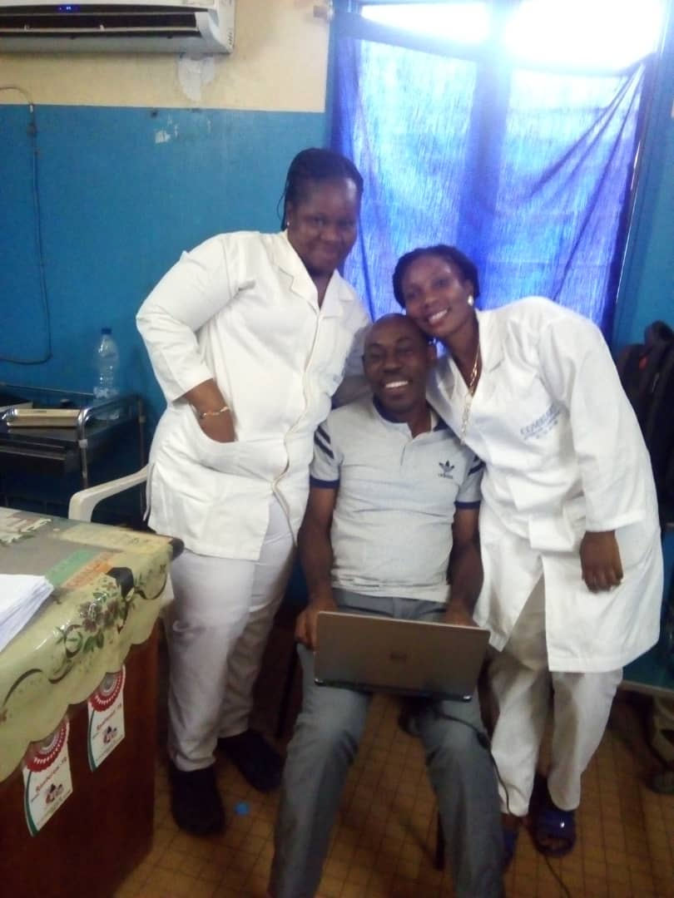
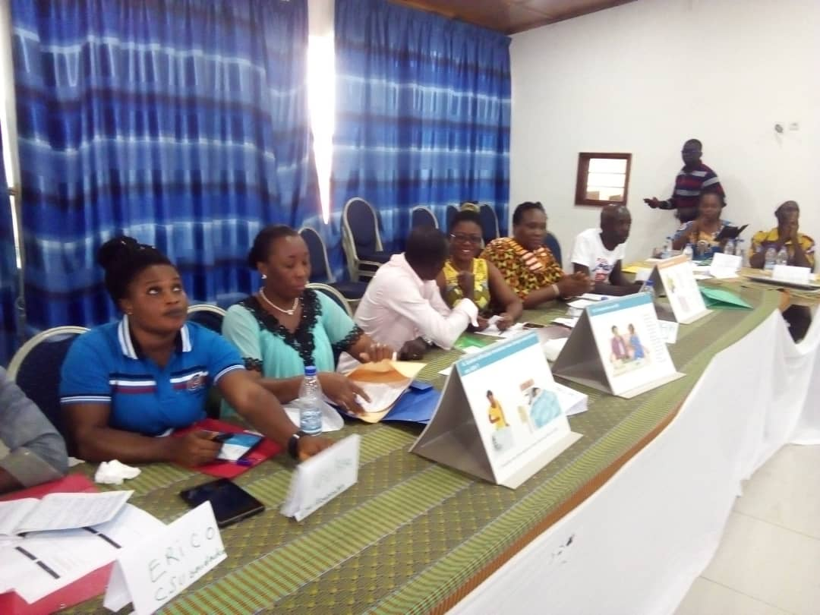
Specific linkage to treatment strategies
Linkage of all HIV-infected patients tested at sites to prompt ART Initiation
  Patient navigation/ physically escort patients
  Revise and supervise patient flow between HTS and ART services
Daily phone call with Community NGOs on patients tested positive in the community and their linkage to prompt ART initiation at the health facility (data exchange)
Notes:
Also, when we consider the targets achievement, we can see an improvement after starting the I-Surge as well as for HTS TST target, ……

Slide 9
2nd 90 Technical Approach
Health Facility
Community
Appointment reminder calls
Routine, same-day Test and Start
If appointment missed, same-day follow-up call made, community surge team notified via WhatsApp group, and patient defaulter card created
Daily monitoring of number of patients initiated on ART (# initiated/# eligible)
Home visit to all newly enrolled clients within 7 days of initiation
Community, workplace, and hotspot campaigns at varying hours and days to discuss benefits of ART and that undetectable equals untransmittable (U=U)
Structured home visits to all pregnant women, with record of each visit that tracks status (if patient agrees) and treatment

Slide 10
3rd 90 Technical Approach
Health Facility
Community
Appointment reminders calls
One-on-one adherence counseling at every visit
Patient card/file alert when due for viral load testing
Defaulter card created on same day as missed appointment, with immediate notification of community surge group
Daily monitoring of viral load coverage (# eligible/# tested)
Proactive patient education on community resources, including community adherence clubs
If patient defaults, supportive home visit provided within 7 days (if viral load due, benefits of viral load testing discussed)
Community-based support groups/adherence clubs
Structured home visits to all ART patients to provide ART counseling and supportive messaging
Structured home visits to all pregnant women to provide adherence counseling

Slide 11
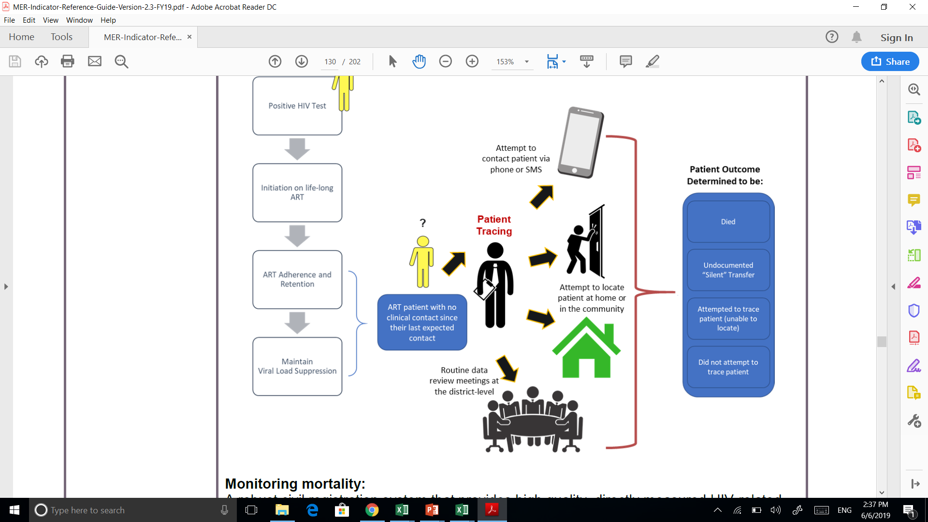
I-SURGE Angola results
PATIENT OUTCOME
33 (2.6%)
Died
620 (51.6%) Undocumented “silent” transfers
100% patients traced
1,202
549 (45.7%)
Attempted to trace but unable to locate
0
Did not attempt to trace
POSTER #: MOPED570
Notes:
For results of I-Surge strategy in Angola and linkage cascade, please check poster.

Slide 12
I-SURGE: Angola results
POSTER #: MOPED570
Notes:
For results of I-Surge strategy in Angola and linkage cascade, please check poster.

Slide 13
I-SURGE Results in DRC
Notes:
Results of I-Surge in DRC

Slide 14
I-SURGE Linkage results in DRC

Slide 15
Conclusions
I-Surge is a new way of working, a paradigm shift
  Primary focus of everyone's support is the site and maximizing the patient encounter
Providing support at both the health facility (pull) and community (push) levels is necessary
  No Partial Credit
I-Surge results showed sustained, positive trends in HIV linkage across all the components of the care cascade, including re-engagement of patients in care.
Notes:
Surge is Acceptable and Feasible- surge has been ongoing since beg. 2018
Surge is flexible- able to adapt to PEPFAR priorities, e.g. CDC early retention priority now
Daily data collection informs and support course correction
Mozambique -reasons for missed appointment/lost follow collected and analyzed
Staff morale improvement noted
Shifting to intensive site level focus not easy
Daily data collection and review takes time but makes a difference in performance and style of working
Need to limit daily data to those most important to 90-90-90
Variability in fidelity to the approach
Leadership dependent
Increased active collaboration between sites/districts and national team
Increased weekly collaboration between CDC, MOH district teams and ICAP
South to South collaboration seen as motivating and very productive

Slide 16
Acknowledgements
ICAP Colleagues
  Dr. Susan Michaels-Strasser
  Dr. Carlos Laudari
Colleagues in CDC country offices and ministries of health in Angola, DRC, Mozambique, Cote D’Ivoire and South Sudan – the early adopters of “I-Surge”
Special recognition and thanks to the people living with HIV around the world
This project is supported by the U.S. President’s Emergency Plan for AIDS Relief (PEPFAR) through CDC under the terms of cooperative agreement #NU2GGH00094. The contents are the responsibility of ICAP and do not necessarily reflect the views of the United States Government.

